Slide 1

TITLE PAGE
Problem Statement ID: HC009
Problem Statement Title: Elderly Fall Detection & Alert System
Domain: Healthcare
Team Name: Lifeline Innovators
Team Leader Name: Saniya Bhandarkar
“Every 11 seconds, an elderly person is treated for a fall. We prevent that delay.”

Slide 2
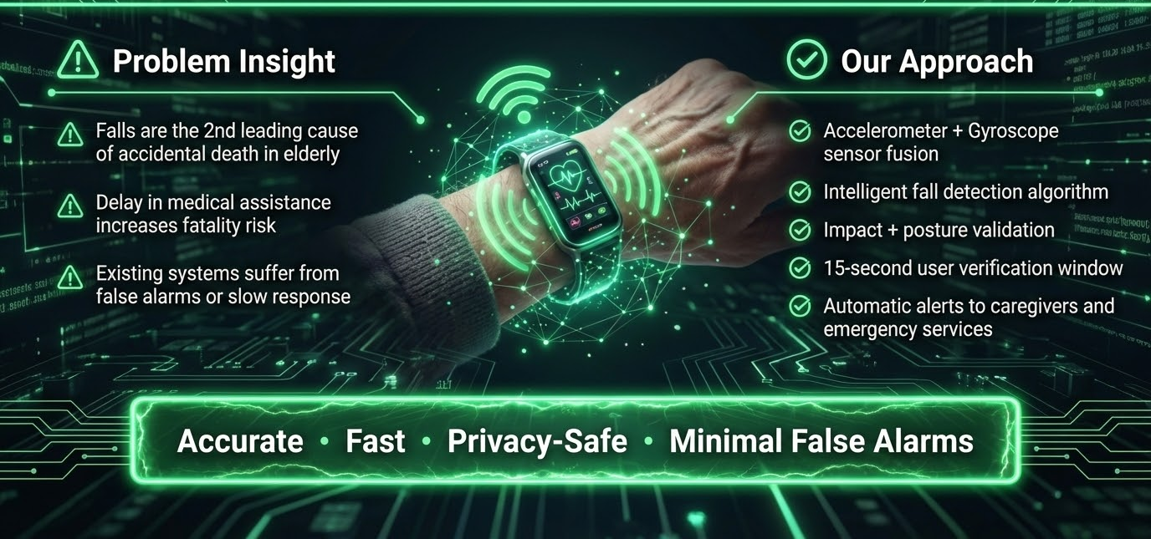
Idea/Approach Details

Slide 3
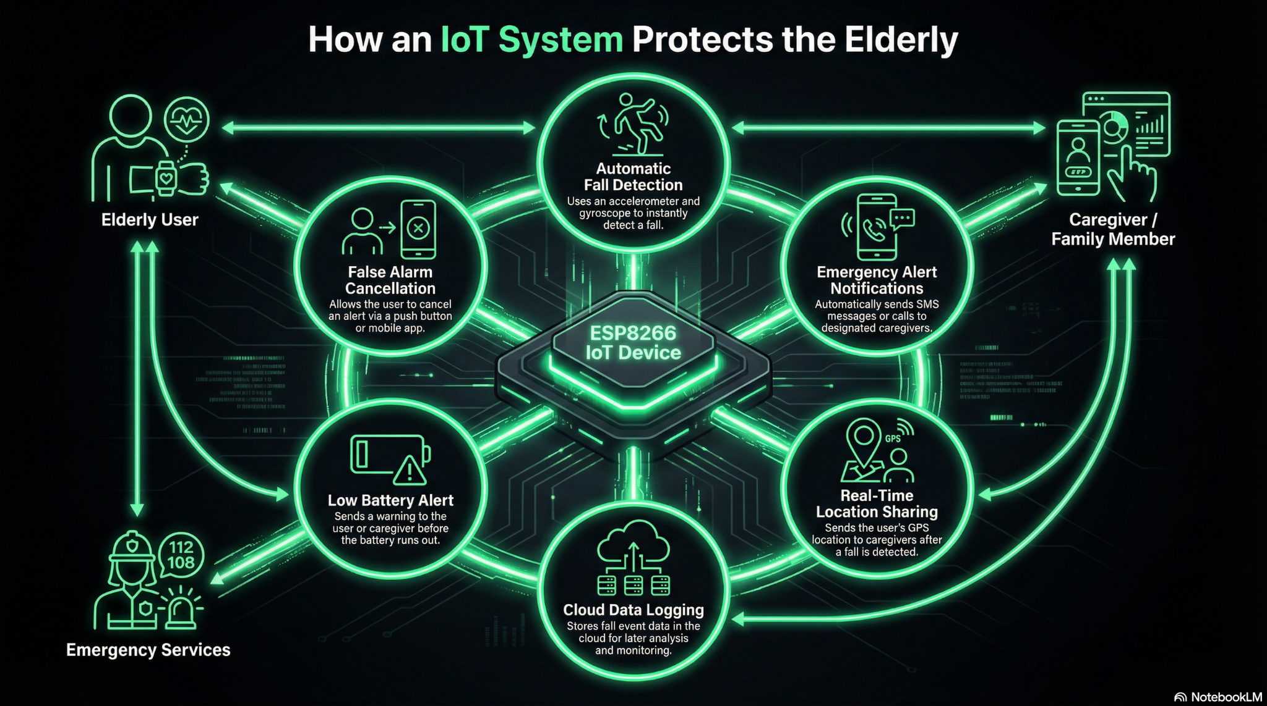
Process flow diagram

Slide 4

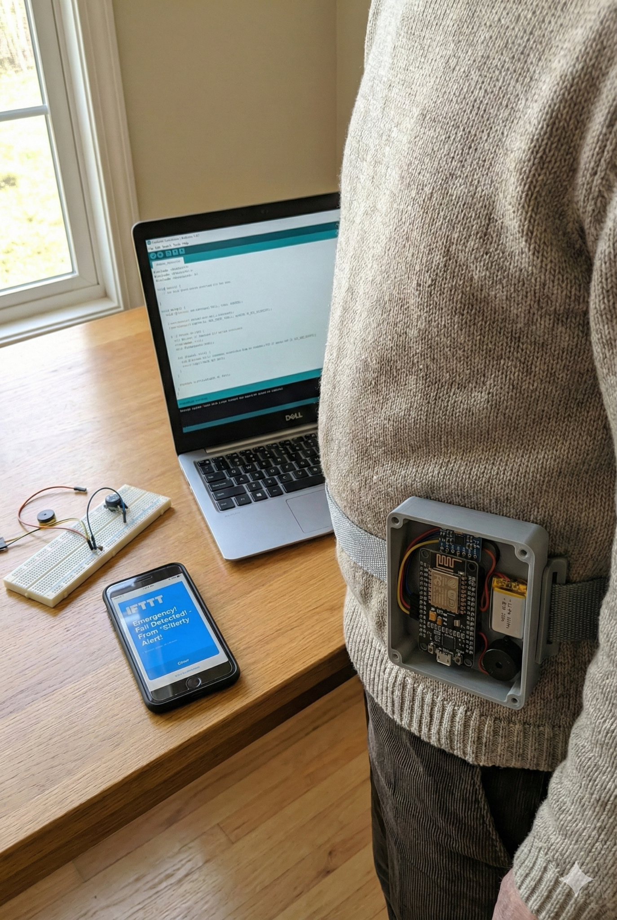
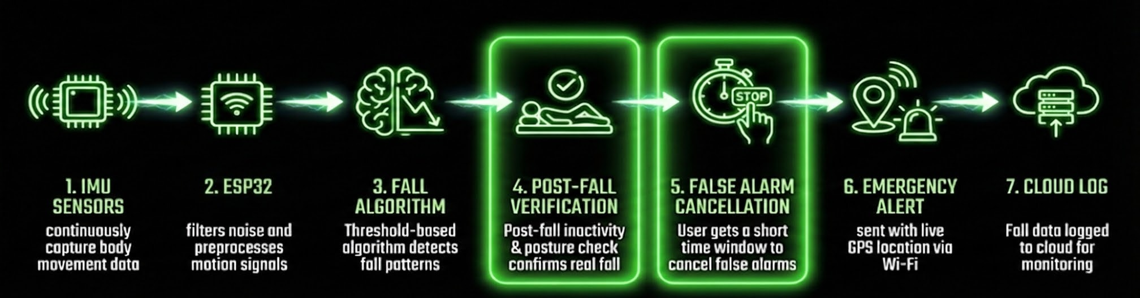
Methodology used

Slide 5
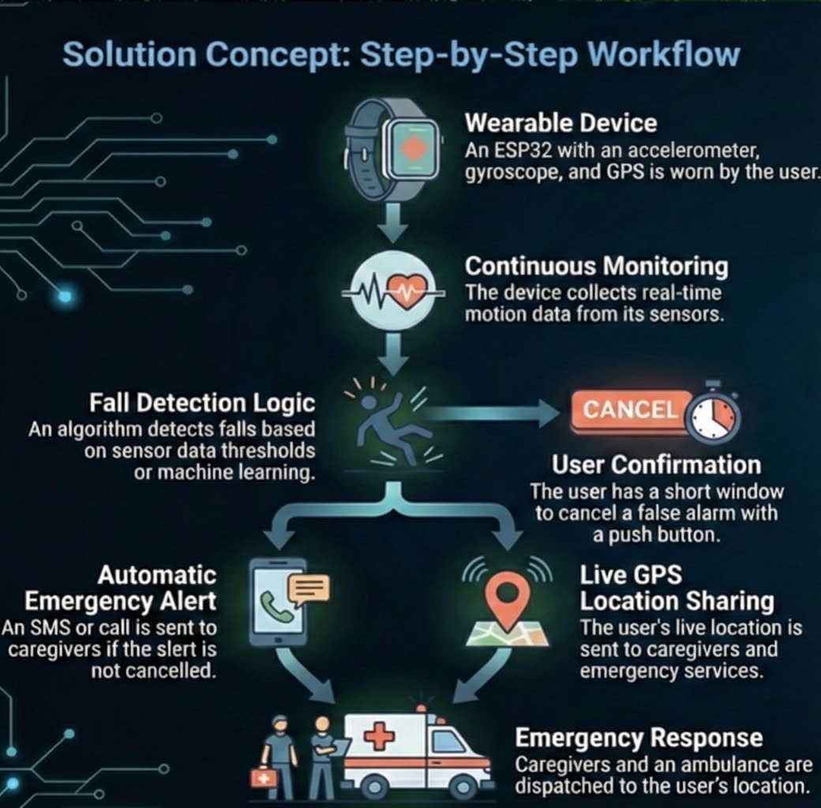
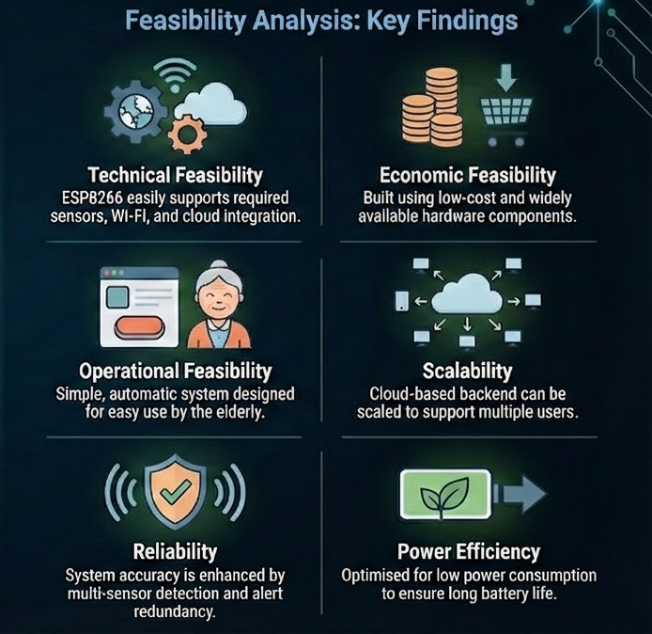
Solution Concept & Feasibility

Slide 6
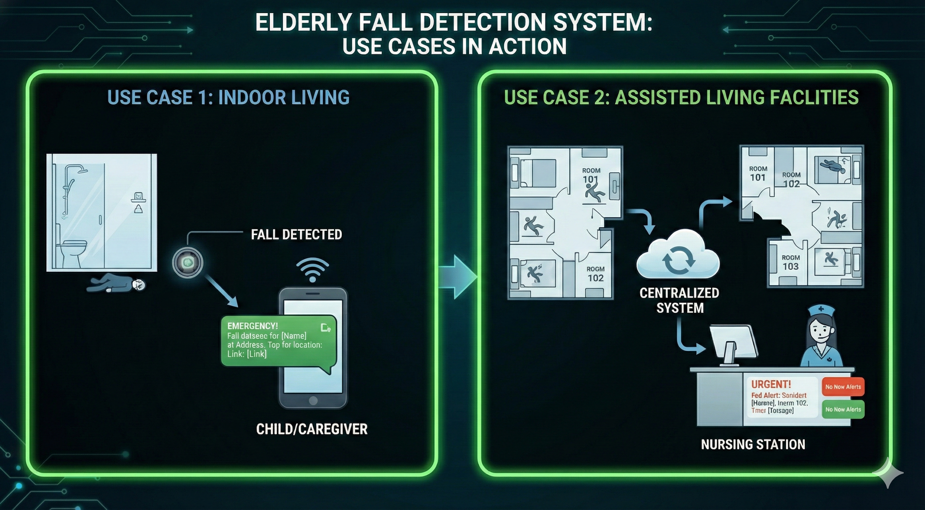
Use cases & description

Slide 7
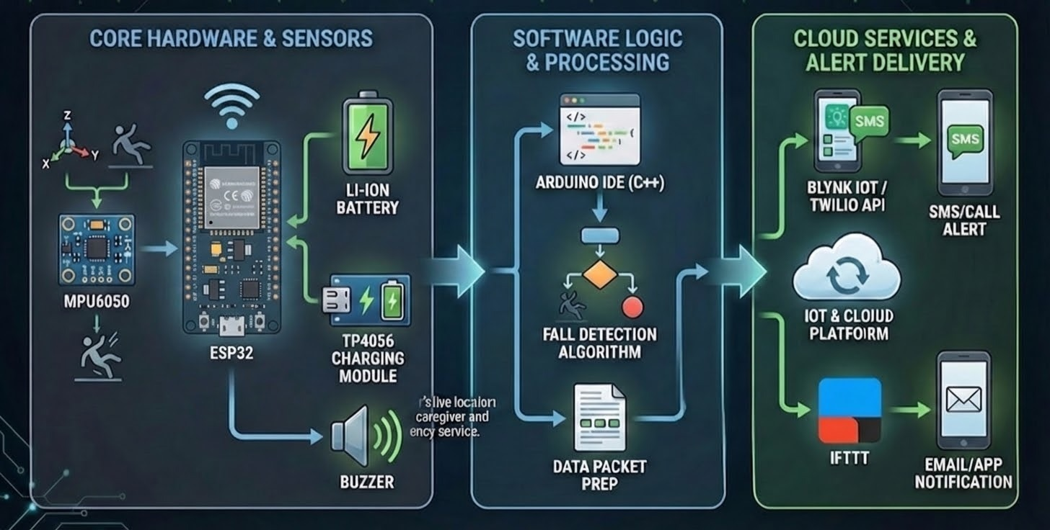
Technology stack used

Slide 8
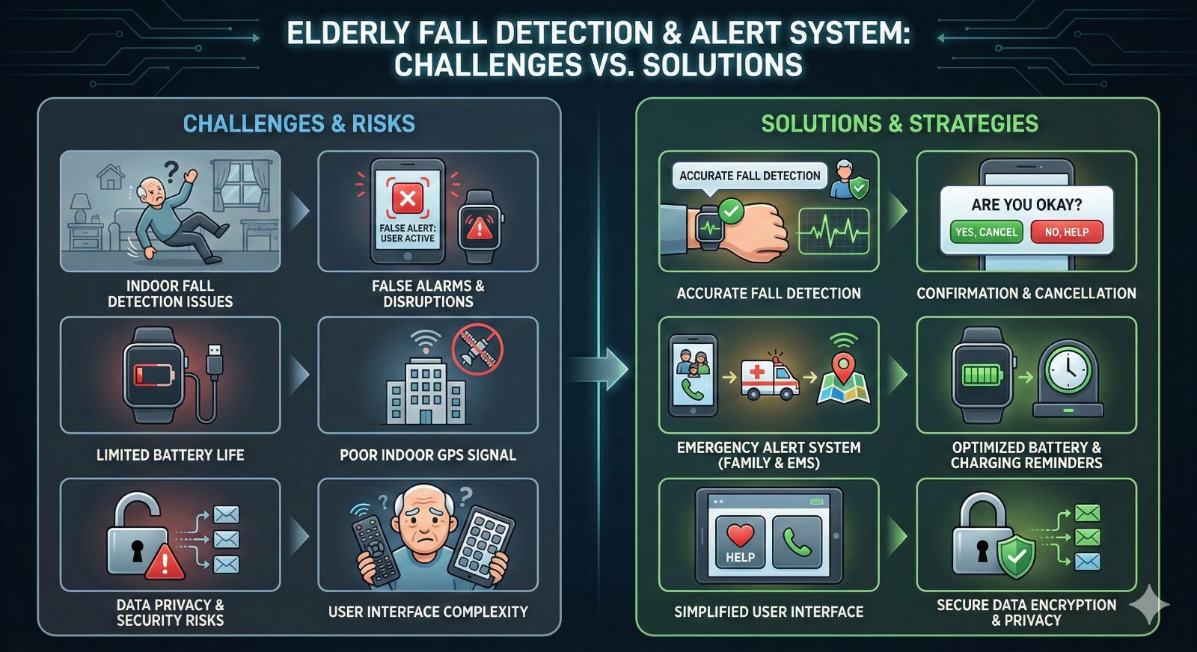
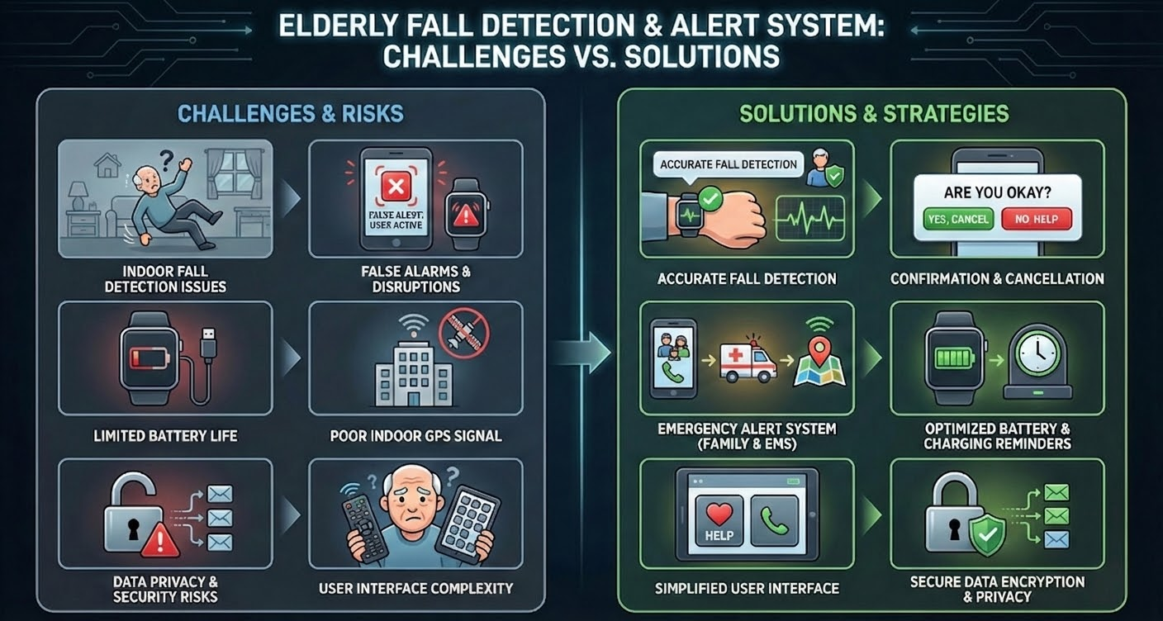
Constraints

